Slide 1
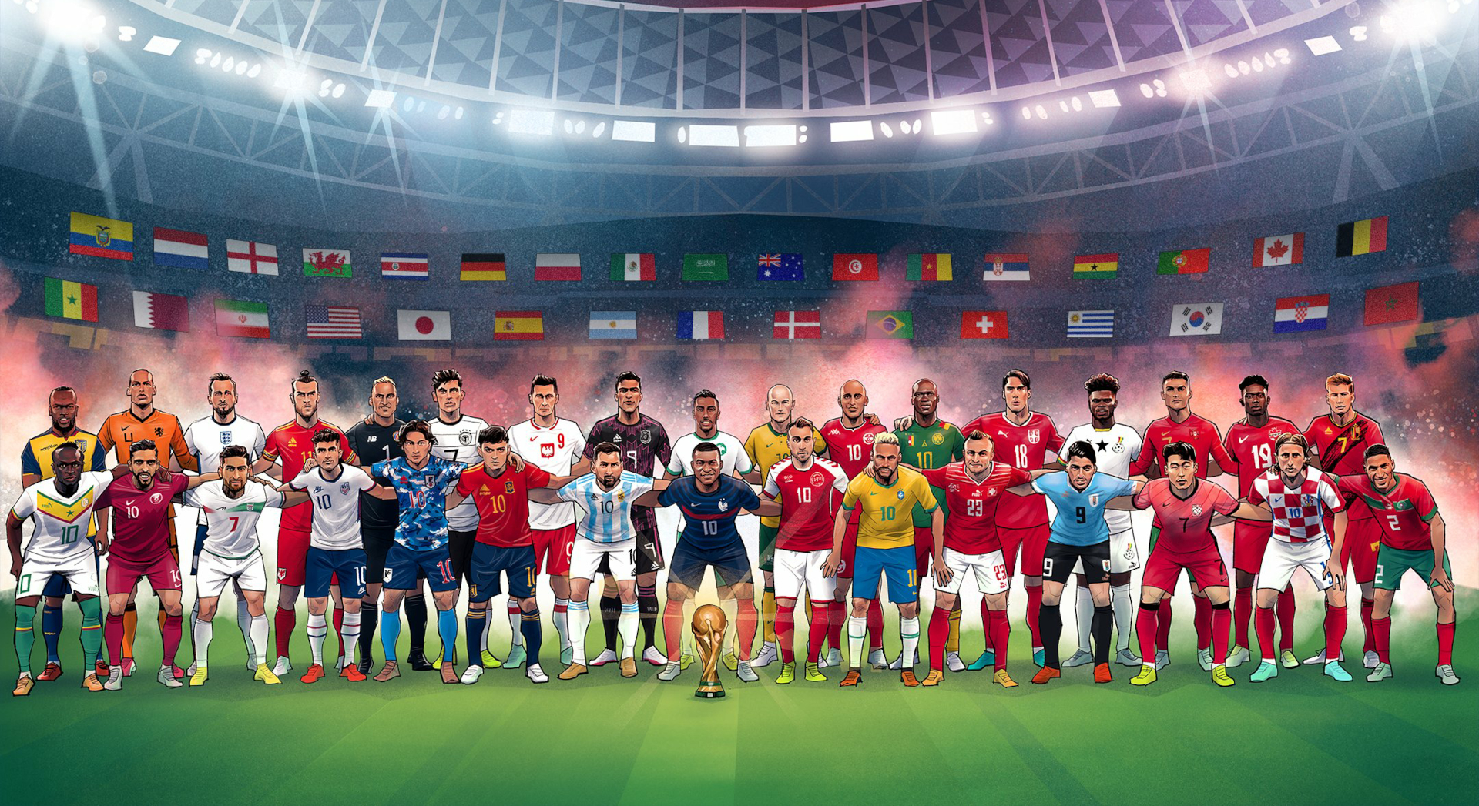

Slide 2
CORRELATION IS CAUSATION
(NOT)
Global Football Diversity:
Exploring the Impact of Multinational Players in World Cups

Slide 3
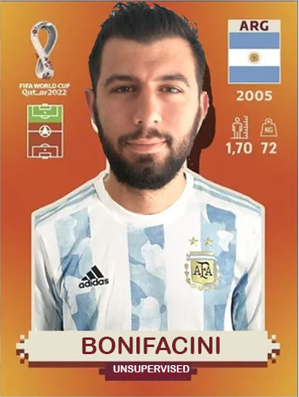
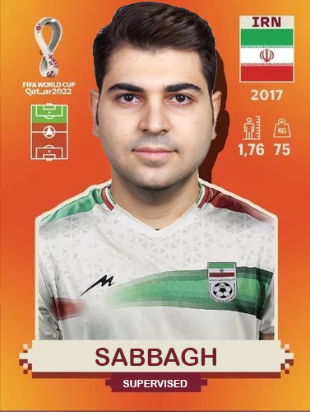

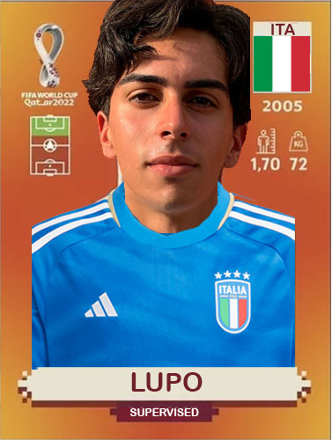


PLAYERS

Slide 4
CONTENTS
Introduction
Datasets
Exploratory Data Analysis
Unsupervised results
Supervised results
Conclusion

Slide 5



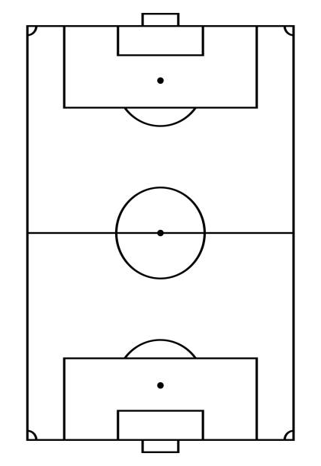

INTRODUCTION
Objective: show that the inclusion of players with nationalities different from their country of origin affects the performance of national teams in the FIFA World Cup.
Question: Does the presence of players who represent a country different from their country of origin influence the performance of national teams in the FIFA World Cup?
Methodology:
Unsupervised learning
Supervised learning

Slide 6
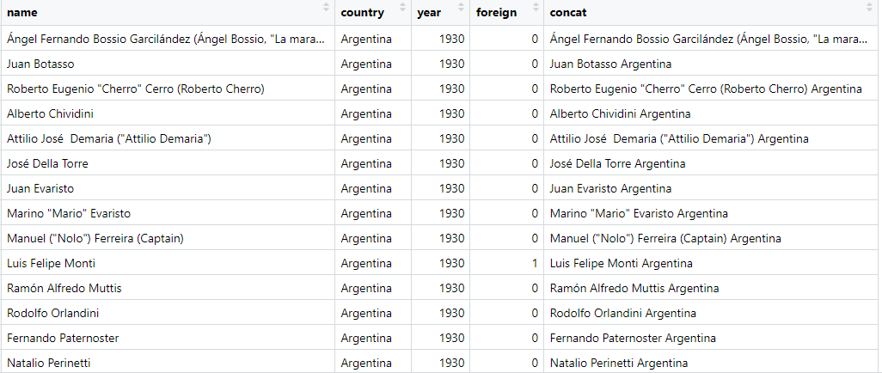

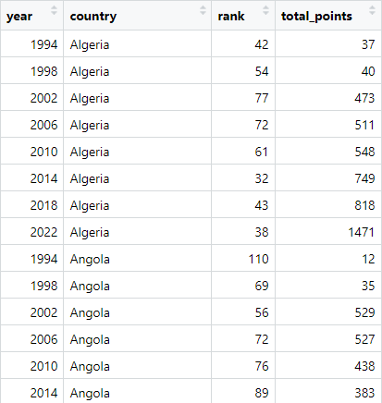
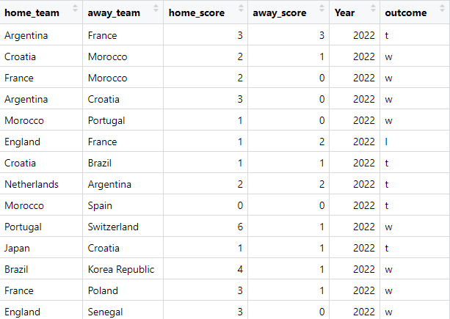

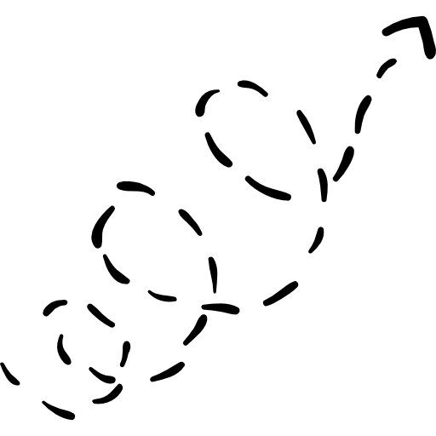

DATASETS
Rows: 10.137
Columns: 5
FINAL
DATASET
Players
DATA
CLEANING
DATA
MANIPULATION
FIFA rank
WC Matches
DATASETS
Rows: 596
Columns: 5
Rows: 964
Columns: 6

Slide 7
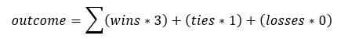
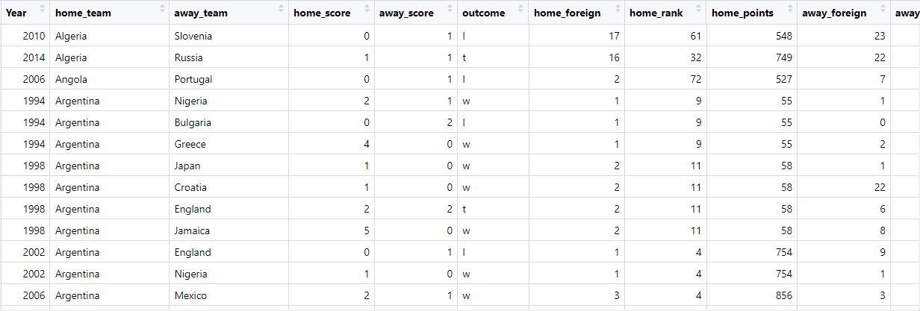
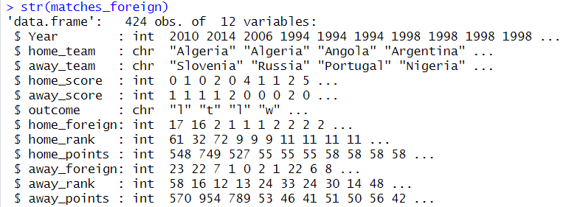
FINAL DATASET
FINAL
DATASET
DATA
CLEANING
DATA
MANIPULATION
DATASETS

Slide 8
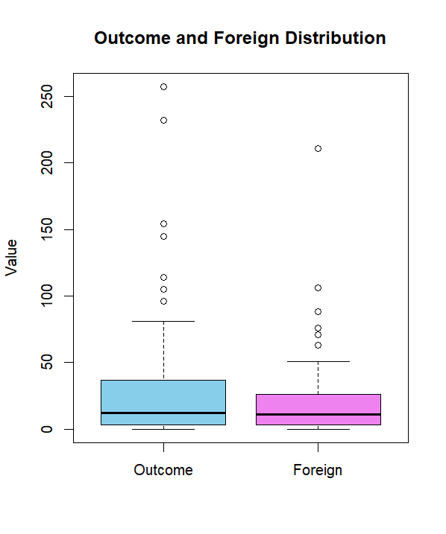
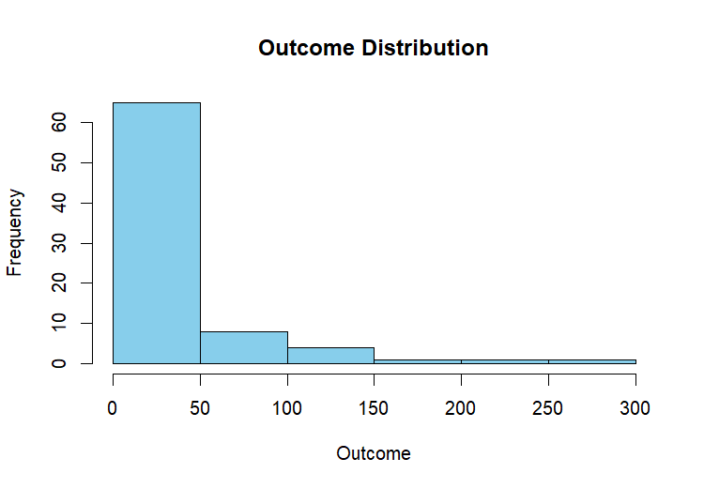
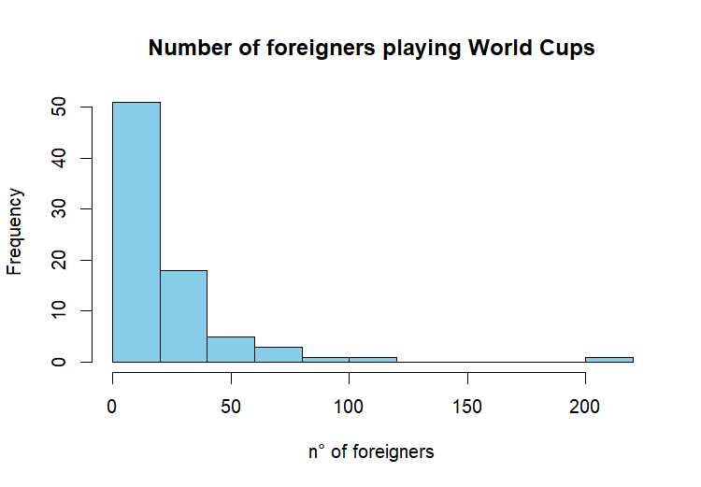
EDA - DISTRIBUTION

Slide 9
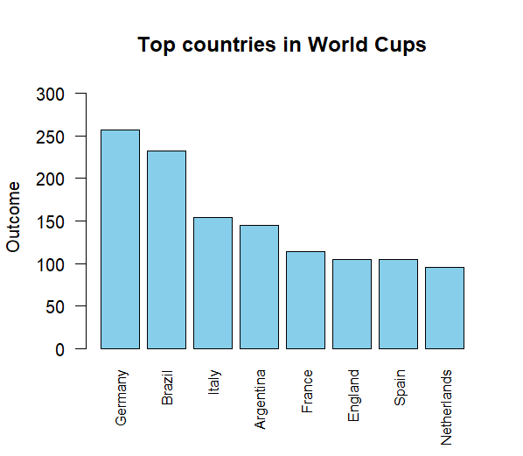
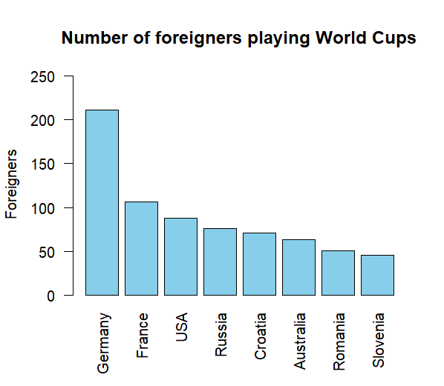
EDA – TOP 8

Slide 10
UNSUPERVISED

Slide 11
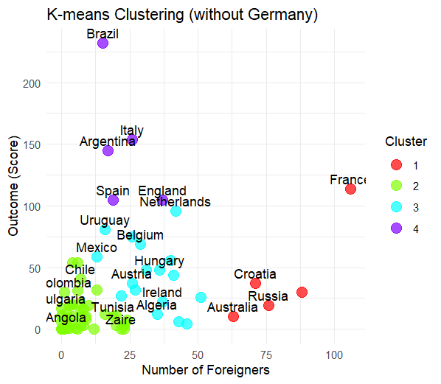
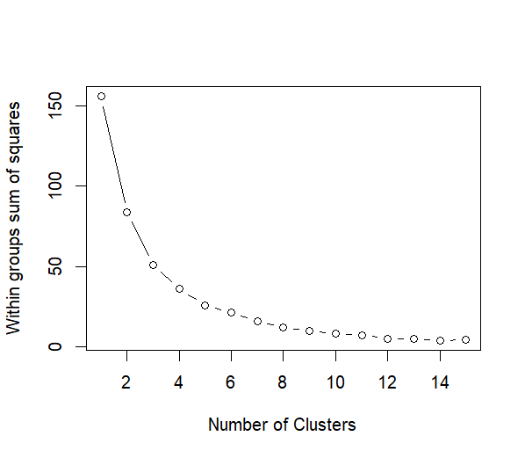
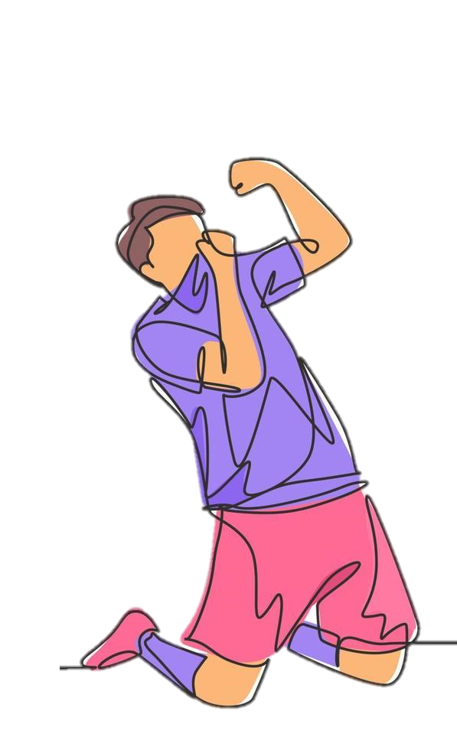
K-MEAN
K = 4
Germany is an outlier in both variables, so we excluded

Slide 12
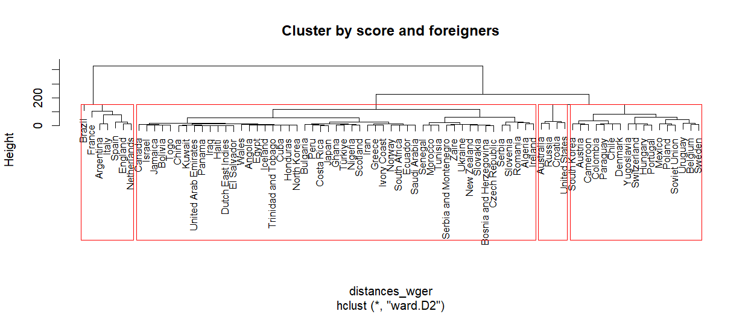
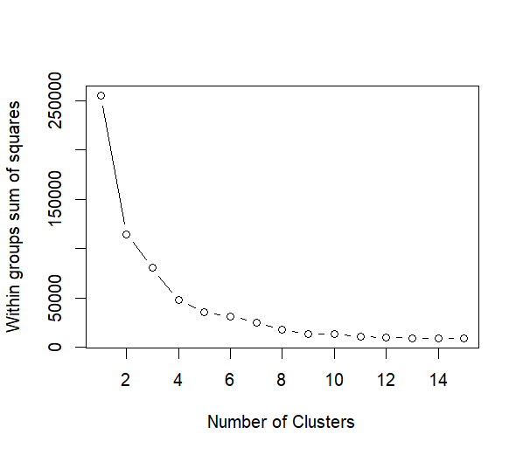
DENDOGRAM
K = 4
Germany is an outlier in both variables, so we excluded

Slide 13
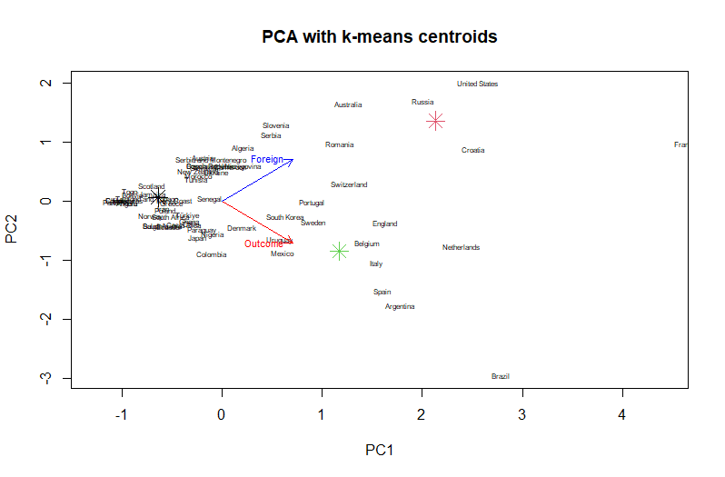
PCA

Slide 14
SUPERVISED

Slide 15
Decision Tree
Random Forest
KNN
WITH TIES
WITHOUT TIES

Slide 16
FEATURE SELECTION
HOME_TEAM
AWAY_TEAM
HOME_SCORE
AWAY_SCORE
HOME_RANK
AWAY_RANK
HOME_POINTS
AWAY_POINTS
HOME_FOREIGN
AWAY_FOREIGN

Slide 17
FEATURE SELECTION
HOME_TEAM
AWAY_TEAM
HOME_SCORE
AWAY_SCORE
HOME_RANK
AWAY_RANK
HOME_POINTS
AWAY_POINTS
HOME_FOREIGN
AWAY_FOREIGN

Slide 18
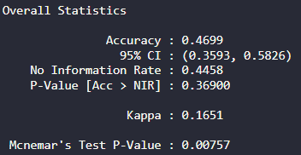
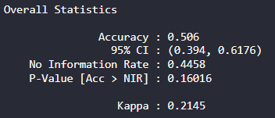
Decision Tree
Foreign Players
No Foreign Players

Slide 19
Decision Tree
Random Forest
No Foreign Players
46.99%
39.76%
Decision Tree
Random Forest
Foreign Players
50.60%
46.99%

Slide 20
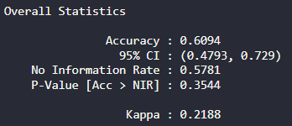
WITHOUT TIES
Decision Tree

Slide 21
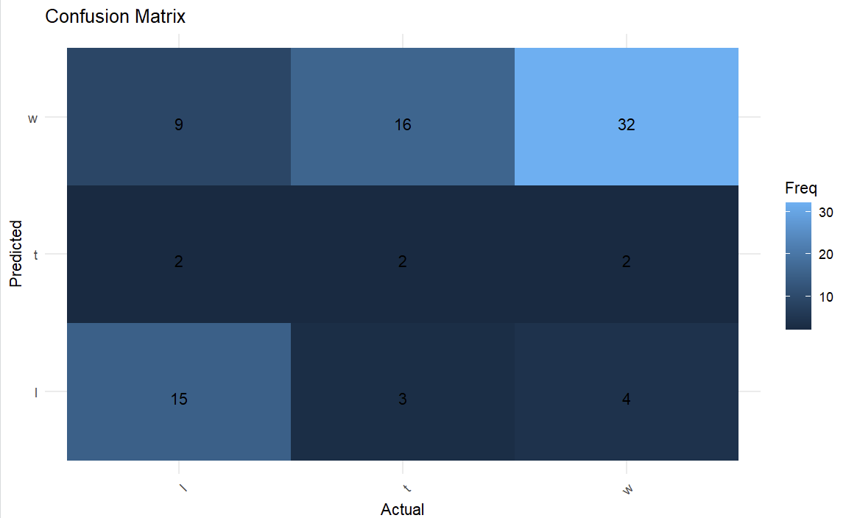
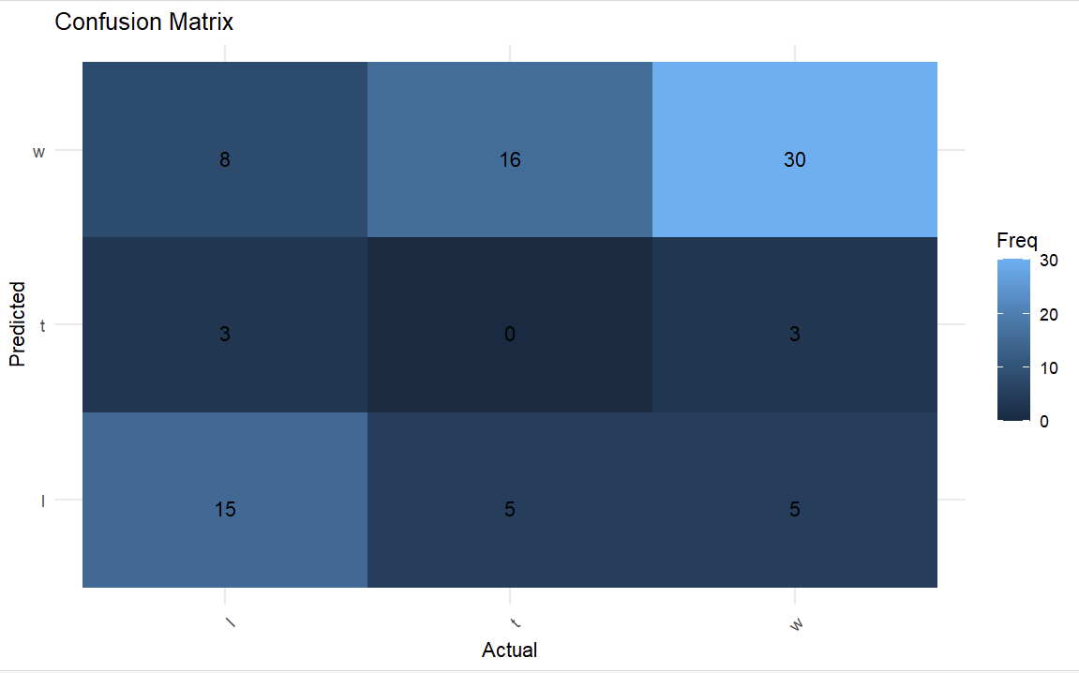
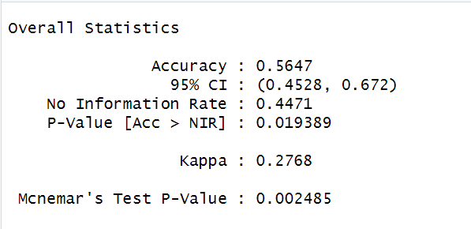
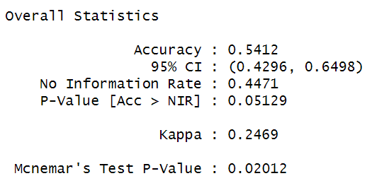
KNN

Slide 22
CONCLUSIONS
- Presence of foreign players might have an impact over World Cup matches
- Need of more complex features
- A new reality that is worth to be analysed

Slide 23

THANKS!
“
"Statistics are just a pattern of information that we have. There are players who make the team play good without the statistics. If you perform to your maximum, if you perform to your best and you helped your team-mates and make the process better, it is enough."
Pep Guardiola

